Slide 1

8th Grade Math: Pre-Algebra
Unit 10, Lesson 5 Interpreting Graphs of Functions Volume 2, pg. 141

Slide 2


Benchmark
MA.8.F.1.3
Analyze a real-world written description or graphical representation of a functional relationship between two quantities and identify where the function is increasing, decreasing, or constant.
volume 2, pg. 141

Slide 3
Integrated Mathematical Thinking and Reasoning Standards
MA.K12.MTR.1.1 Actively participate in effortful learning both individually and collectively.
MA.K12.MTR.2.1 Demonstrate understanding by representing problems in multiple ways.
MA.K12.MTR.4.1 Engage in discussions that reflect on the mathematical thinking of self and others.
MA.K12.MTR.6.1 Assess the reasonableness of solutions.
MA.K12.MTR.7.1 Apply mathematics to real-world contexts.
volume 2, pg. 141

Slide 4

Learning Targets
I can identify where a function is increasing, decreasing, or constant from its graph.
I can write a description of a graphical representation of a function in context.
volume 2, pg. 141

Slide 5

Warm-Up
volume 2, pg. 141

Slide 6
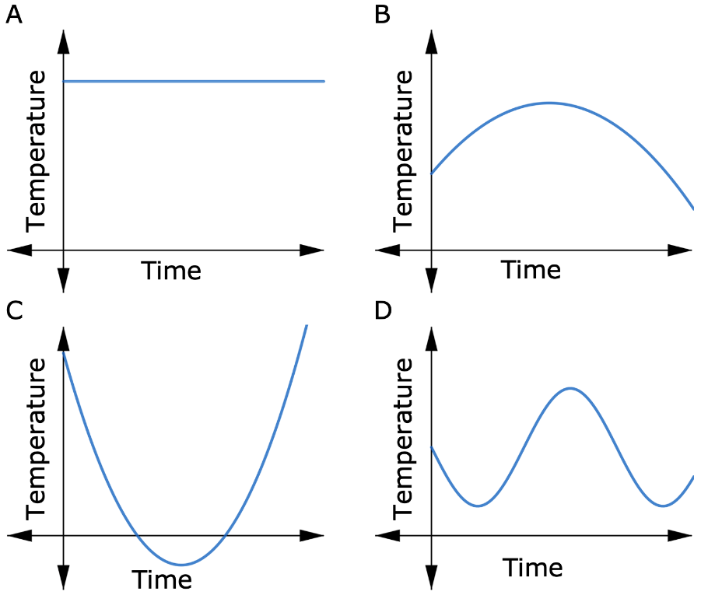
10.5.1 Warm-Up: Which One Doesn’t Belong?
Four graphs show the relationship between temperature and time.
volume 2, pg. 141

Slide 7
Which one doesn’t belong?
Explain your choice.
volume 2, pg. 141

Slide 8

Exploration
volume 2, pg. 142

Slide 9

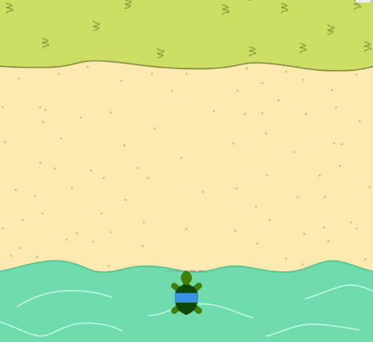
10.5.2 Exploration: Distance Versus Time Graphs
A turtle is traveling across the sand.
Draw a graph using line segments to represent a possible path the turtle could take.
volume 2, pg. 142

Slide 10
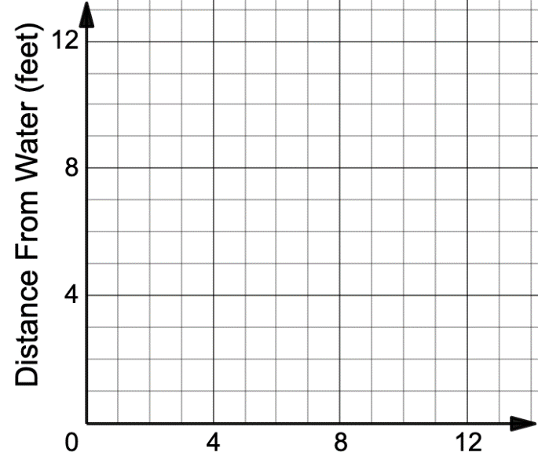
Write a brief story describing the turtle’s journey based on your graph.
Time (seconds)
Share your graph and story with your partner. Discuss any differences in your graphs or interpretations. Make revisions to your story or graph, if necessary.
volume 2, pg. 142

Slide 11
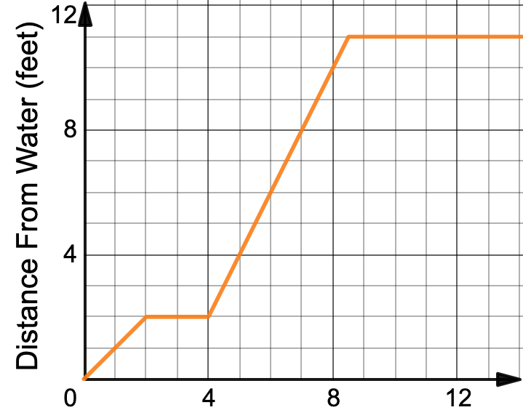
Luca drew the graph shown to represent a new turtle’s journey across the sand.
Time (seconds)
volume 2, pg. 142

Slide 12
On your own, label the graph as described below.
Label any parts of the graph where Luca’s turtle is walking away from the water with the letter 𝑎.
Label any parts of the graph where Luca’s turtle is standing still with the letter 𝑏.
Label any parts of the graph where Luca’s turtle is walking toward the water with a letter 𝑐.
Compare your labels with your partner and resolve any differences, if necessary.
volume 2, pg. 142

Slide 13
Work with your partner to answer the following using Luca’s graph.
What is the turtle’s distance from the water at 8 seconds?
When is the turtle’s distance from the water 4 feet?
Based on the graph, the turtle is walking between 0 and 2 seconds, and between 4 and 8.5 seconds. Determine whether the turtle is traveling faster between 0 and 2 seconds, or between 4 and 8.5 seconds.
volume 2, pg. 143

Slide 14
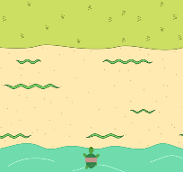
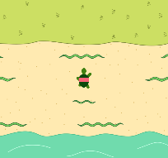
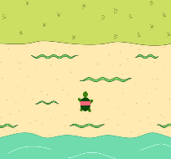
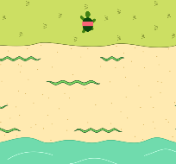
Four screenshots and brief descriptions from an animation are shown. In the animation, a turtle is being careful to avoid crawling snakes as it walks across the sand.
Screenshot | Description
 | The turtle begins in the water.
 | Avoiding the crawling snakes, the turtle walks forward at a constant rate until the point shown, where he stops for a few seconds while a snake passes by.
 | Then, the turtle backs up to avoid another snake. He waits a few seconds there.
 | The turtle then hurries across the rest of the sand to safety.
volume 2, pg. 143

Slide 15

On your own, draw a graph of the turtle’s distance from the water over time based on the description in the table.
Time (seconds)
Compare your graph with your partner. Discuss your graphs and make any changes, if necessary.
volume 2, pg. 144

Slide 16

Bring It Together
volume 2, pg. 144

Slide 17


10.5.3 Bring It Together: Distance Versus Time Graphics
In graphs comparing time as the independent variable and distance as the dependent variable, the slope of the line represents _________________.
Speed vs. Velocity
Speed is the rate at which an object is moving in units of distance per unit of time.
Velocity is the rate and direction of an object’s movement.
The slope of a line gives both the rate of change and the direction of the change, positive or negative, so it can be used to determine both the speed and the velocity of an object.
volume 2, pg. 144

Slide 18
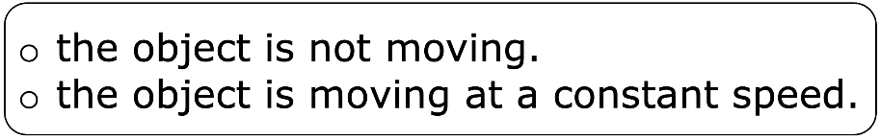
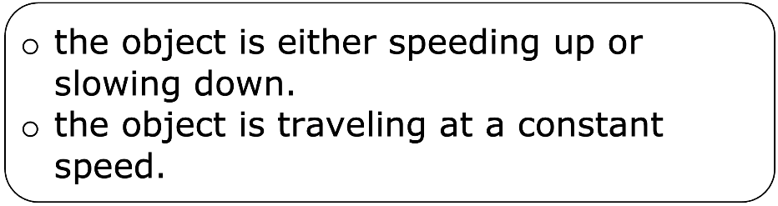
Complete each statement.
On a distance-time graph, a horizontal line
means
On a distance-time graph, a diagonal line
means
How can the speed of the object be determined for a line segment on a distance-time graph?
volume 2, pg. 144

Slide 19

Guided Practice
volume 2, pg. 145

Slide 20

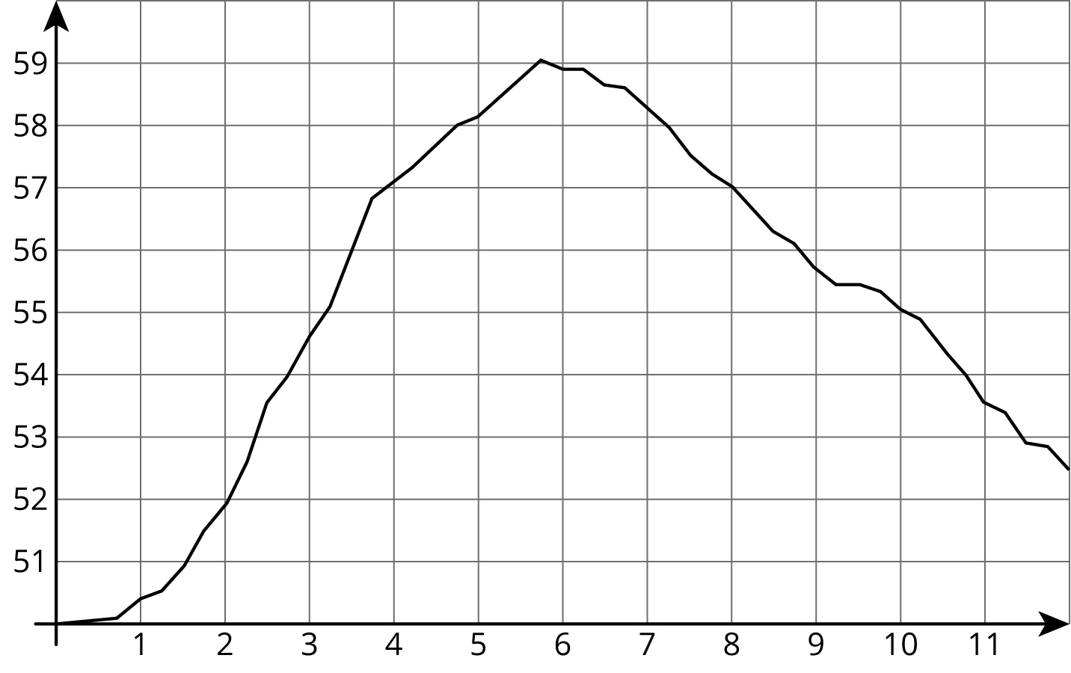

10.5.4 Guided Practice: Interpreting Graphs of Functions
The graph shows the temperature between noon and midnight one December day in Freeport, Florida.
Temperature ($F°$)
Time (hours since noon)
volume 2, pg. 145

Slide 21
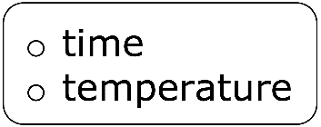
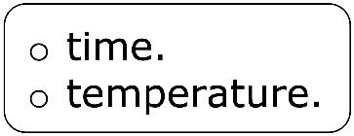
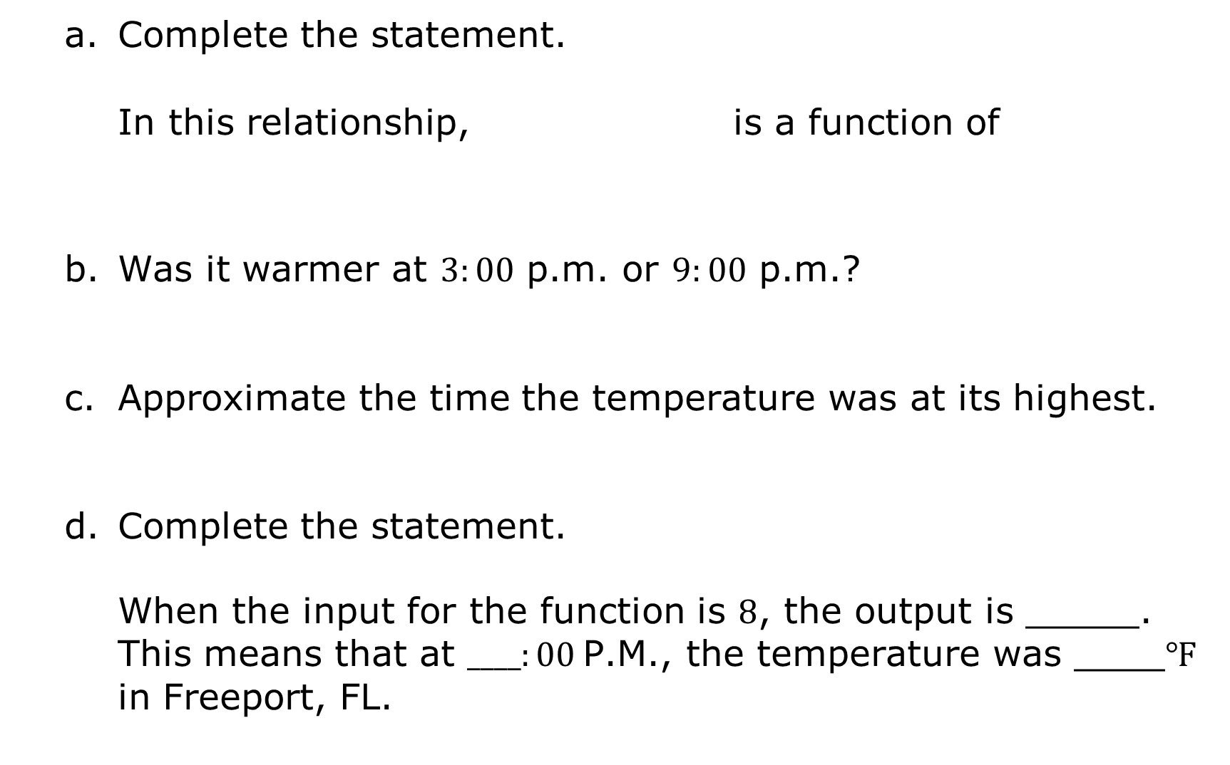
Complete the statement.
In this relationship, is a function of
Was it warmer at $3:00$ p.m. or $9:00$ p.m.?
Approximate the time the temperature was at its highest.
Complete the statement.
When the input for the function is $8$, the output is _____. This means that at $____:00$P.M., the temperature was ____$℉$ in Freeport, FL.
volume 2, pg. 145

Slide 22
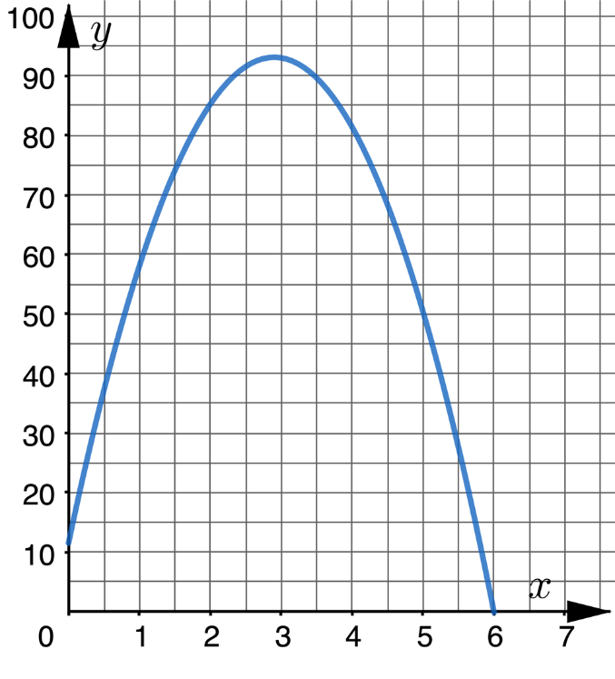
The graph represents a bottle rocket that is shot upward from an outdoor stage and then falls to the ground. The independent variable is time, in seconds, and the dependent variable is the object’s height above the ground, in meters.
Height (meters)
Time (seconds)
volume 2, pg. 145

Slide 23
Complete the description of the story told by the graph.
The bottle rocket is launched from an outdoor stage that is _____ meters above the ground. It continues flying upward for about _____ seconds until it reaches approximately _____ meters above the ground. The rocket then begins to fall, landing on the ground after about _____ seconds.
Complete the statement and the inequality.
The domain of the function that represents the rocket’s path is between ___ and ___ seconds.
$$≤ x ≤$$
volume 2, pg. 145

Slide 24

Wrap-Up
volume 2, pg. 146

Slide 25
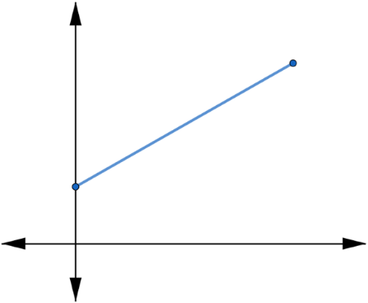
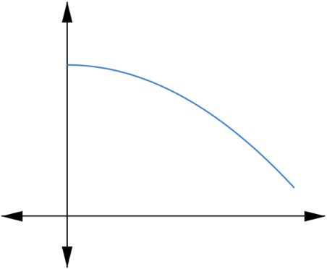
10.5.5 Wrap-Up: Ticket Out the Door
Two graphs are shown.
Graph A | Graph B
volume 2, pg. 146

Slide 26
Complete the table by writing the letter of the graph that matches each description. Then, name possible independent and dependent variables that could be used to label the axes.
Description | Graph | Independent Variable | Dependent Variable
A plant grows the same amount every week.
The day started very warm but then it got colder.
volume 2, pg. 146

Slide 27
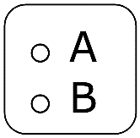
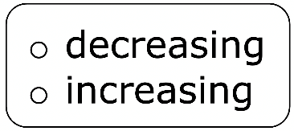
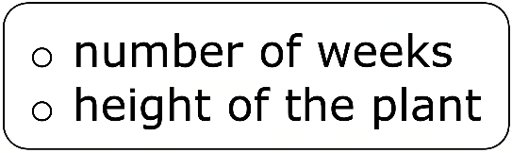
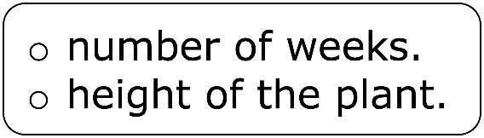
Complete the statement.
Graph shows the function over the interval shown to model how the changes over the
volume 2, pg. 146

